Slide 1
A new model of neuron-astrocyte networks and validation of the Porto-Pazos model

Slide 2

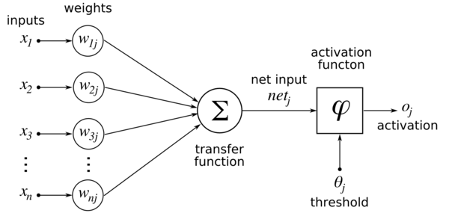

Slide 3
X1 | X2 | W1 | W2 | Oj | Target
0 | 0 |  |  |  | 0
0 | 1 |  |  |  | 1
1 | 0 |  |  |  | 1
1 | 1 |  |  |  | 2

Slide 4
X1 | X2 | W1 | W2 | Oj | Target
0 | 0 | 0.2 | 0.3 | 0 | 0
0 | 1 | “ | “ | 0.3 | 1
1 | 0 | “ | “ | 0.2 | 1
1 | 1 | “ | “ | 0.5 | 2

Slide 5
X1 | X2 | W1 | W2 | Oj | Target
0 | 0 | 1 | 1 | 0 | 0
0 | 1 | “ | “ | 1 | 1
1 | 0 | “ | “ | 1 | 1
1 | 1 | “ | “ | 2 | 2

Slide 6
X1 | X2 | W1 | W2 | Oj | Target
0 | 0 | 1 | 1 | 0 | 0
0 | 1 | “ | “ | 1 | 1
1 | 0 | “ | “ | 1 | 1
1 | 1 | “ | “ | 2 | 0

Slide 7
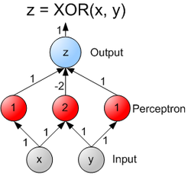
X1 | X2 | Oj | Target
0 | 0 | 0 | 0
0 | 1 | 1 | 1
1 | 0 | 1 | 1
1 | 1 | 2 | 0

Slide 8
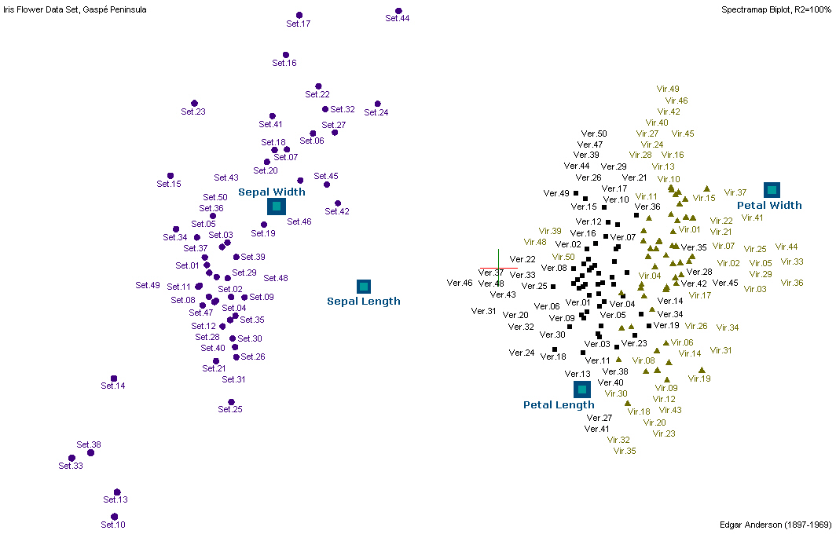

Slide 9
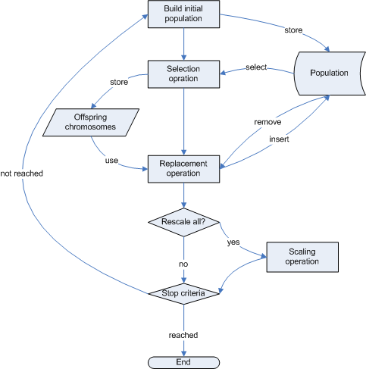

Slide 10
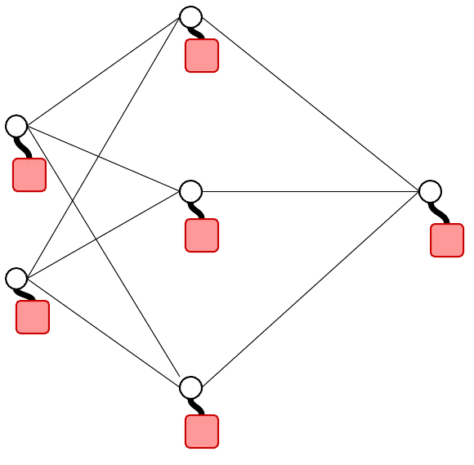

Slide 11
